Slide 1

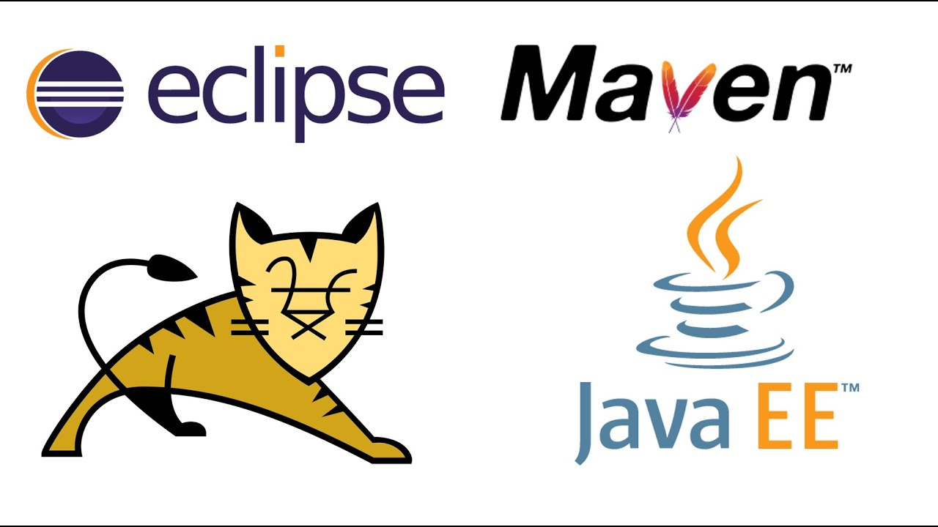
MAVEN and Tomcat for green button
By: Brandon montano

Slide 2
What is maven
It is a build tool- generates the source code, documentation, compiling, and packs the complied codes into Jar files, then installs the packaged code in a local repository or a server.
Project management tool it helps in building and documenting the project
It is written in Java and C#

Slide 3
Project object model
Maven is based on a project object model this is a xml file that has all the information regarding the project and configuration details.
Thus simplifying Java projects

Slide 4
Makes things easier
Gets the right Jar files and downloads dependences so your not downloading everything manually (use .xml file) for software versions
Goes to mvnrepository.com which has all dependences then stores it in local cache
Making sure it will always work correctly
Again it
1st describes how the software is built
2nd describes the dependences your java project needs

Slide 5
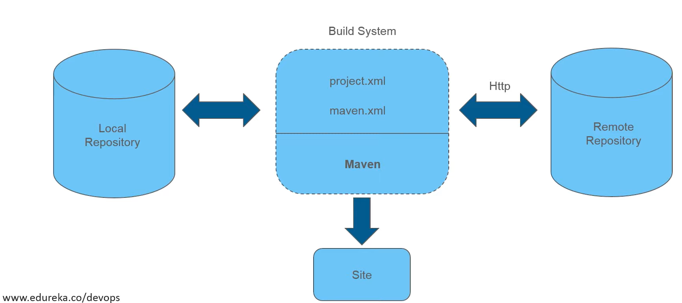
Maven architecture

Slide 6
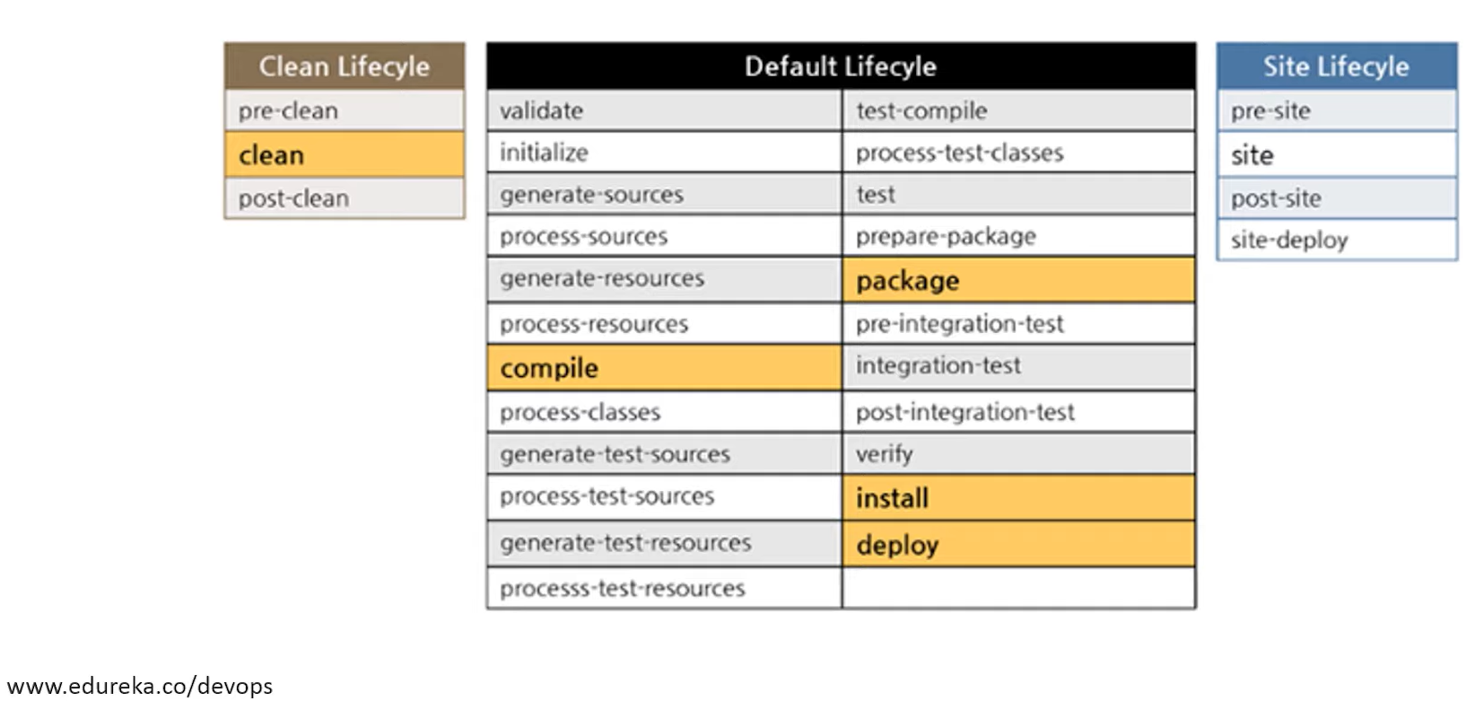
Maven lifecycle

Slide 7
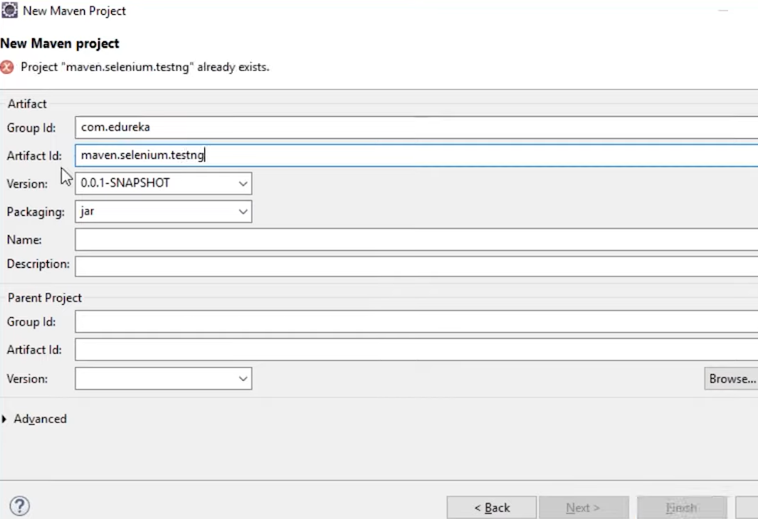
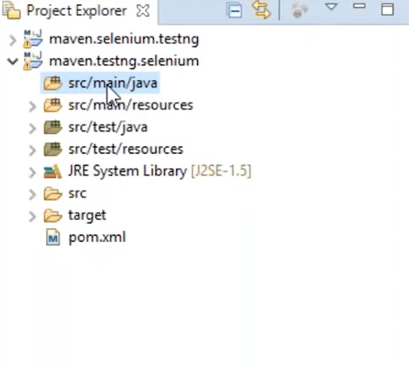
Using Maven with an ide
Create a new Maven Project

Slide 8
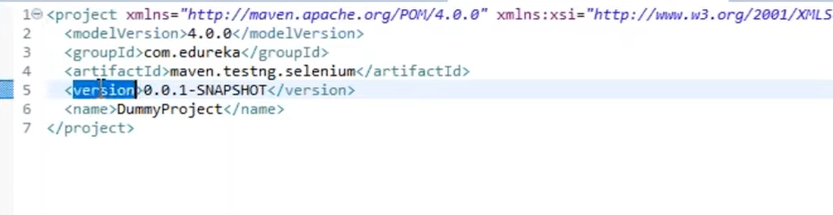
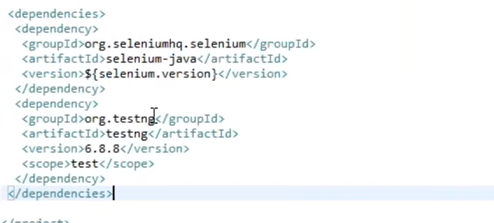
Pom.xml
The most important part of Maven

Slide 9
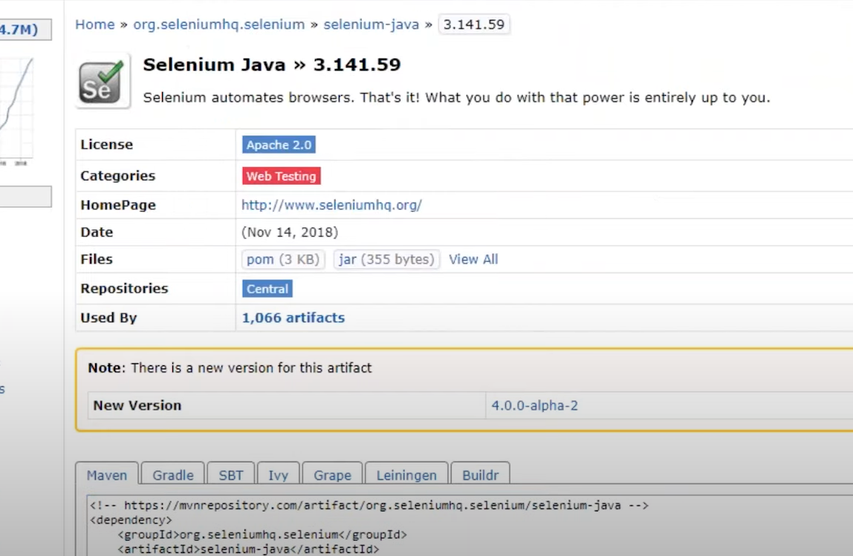
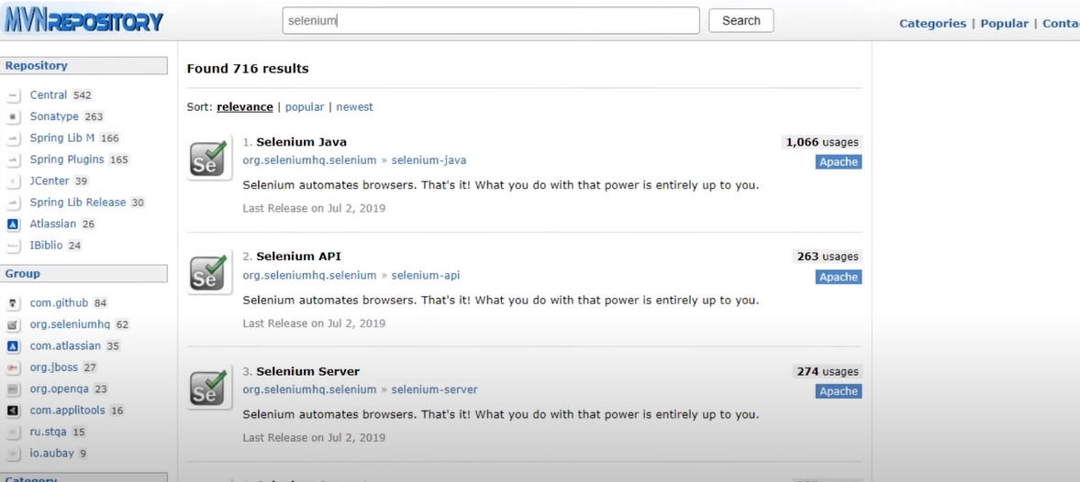
Use mvn repository libraries and plugins

Slide 10
How this relates to our project
Selenium and SoapUI are under the same bracket of tools, but they are not the same tools. Both Selenium and SoapUI are used for testing the web. SoapUI specializes in the web service end, and Selenium specializes in automating the actual web application. ... Selenium: Automate web browsers.
https://stackoverflow.com/questions/34135884/what-is-the-difference-between-selenium-webdriver-and-soapui#:~:text=Selenium%20and%20SoapUI%20are%20under,automating%20the%20actual%20web%20application.&text=Selenium%3A%20Automate%20web%20browsers.

Slide 11
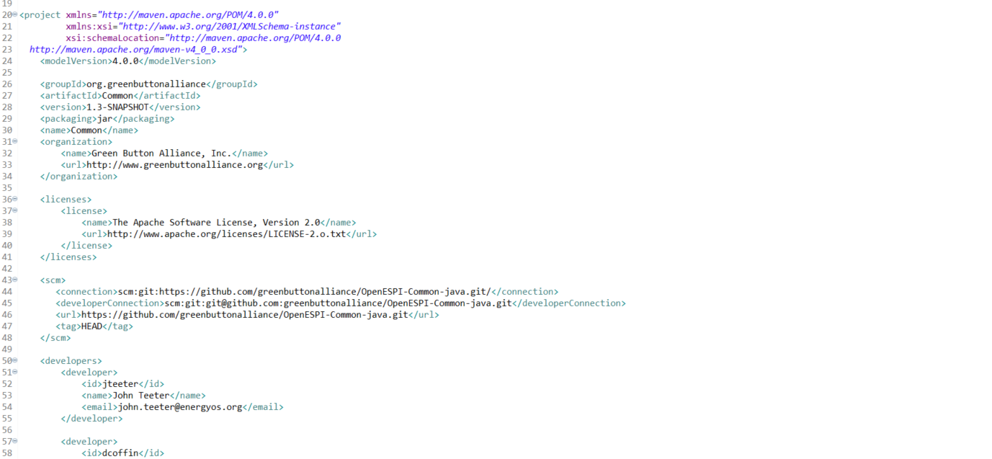
Our xml

Slide 12
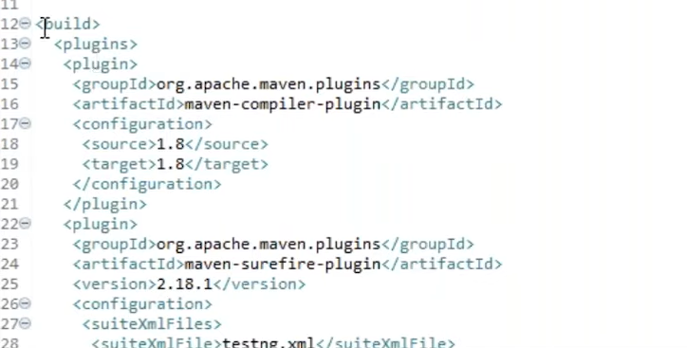
Always need the build and test plugins in your xml file

Slide 13
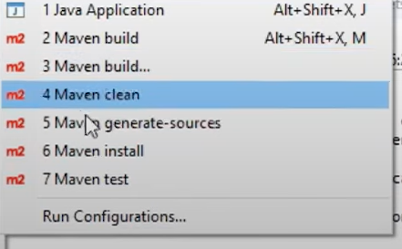
Now time to run clean then generate sources then maven build

Slide 14
tomcat
When using servlets and spring you need tomcat
Spring Framework is an application framework and inversion of control container for the Java platform
Server for http to make it dynamic we then use servlets
Static page server gives html page in response to the page (prebuilt)
Dynamic page that created in runtime like a facebook page it is not prebuilt this is done via helper application your web container(tomcat)
Dynamic data server to run servlet container this is tomcat
Servlets= (server component that runs on a server thus giving a output that is the client page) (java servlet)
To make servlet
public class name extends httpservlet{
Service(request, response){}
}
The request from the user to a web.xml file that then calls your name class to carry out a task then return the dynamic page back to your client is known as tomcat(web container).

Slide 15
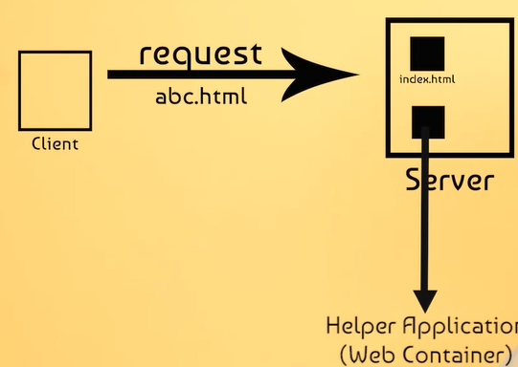
tomcat
Http server (port 8080) and servlet container this then is tomcat
Port 8443 is the standard for Tomcat secured (SSL/TLS) data
Apache tomcat is free just have to install on your ide.

Slide 16
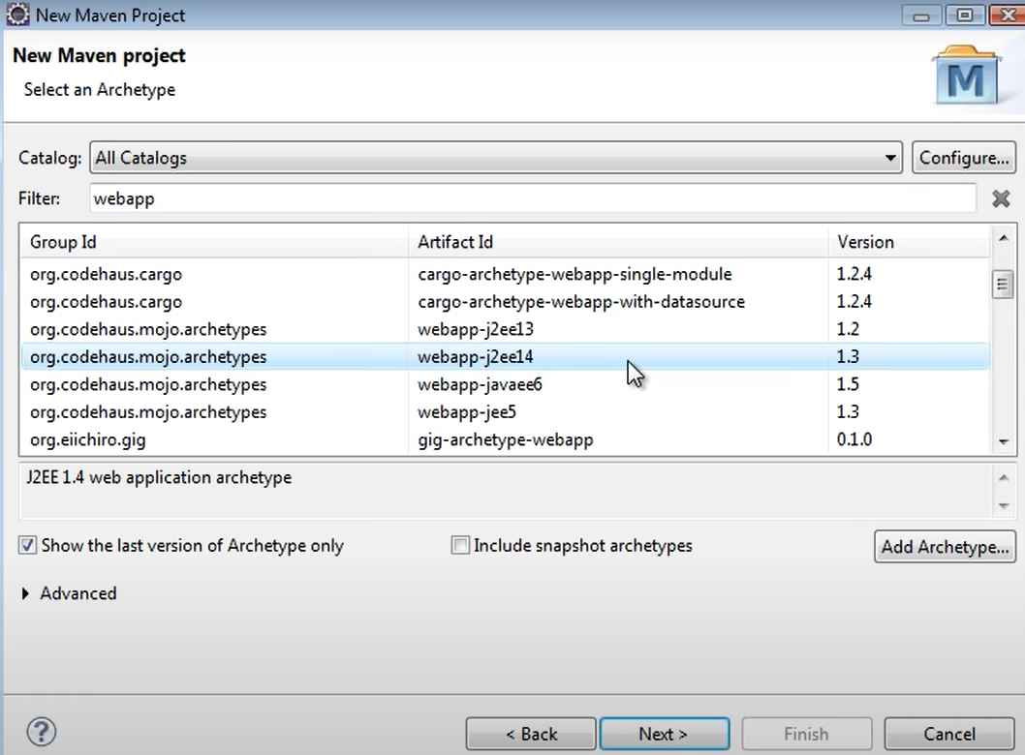
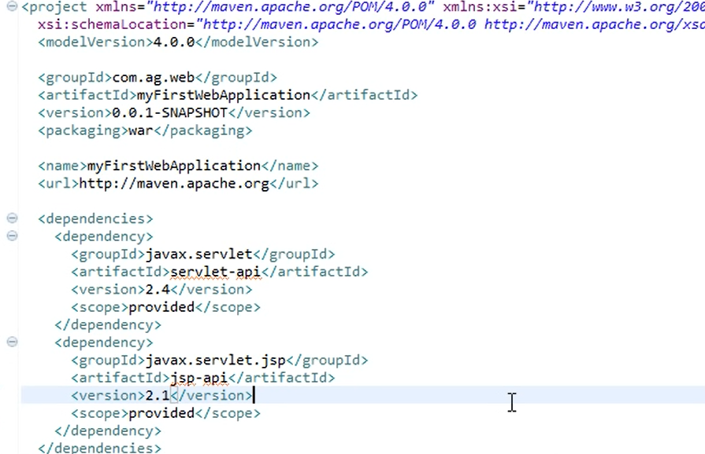
Programming examples for maven and tomcat implementation

Slide 17
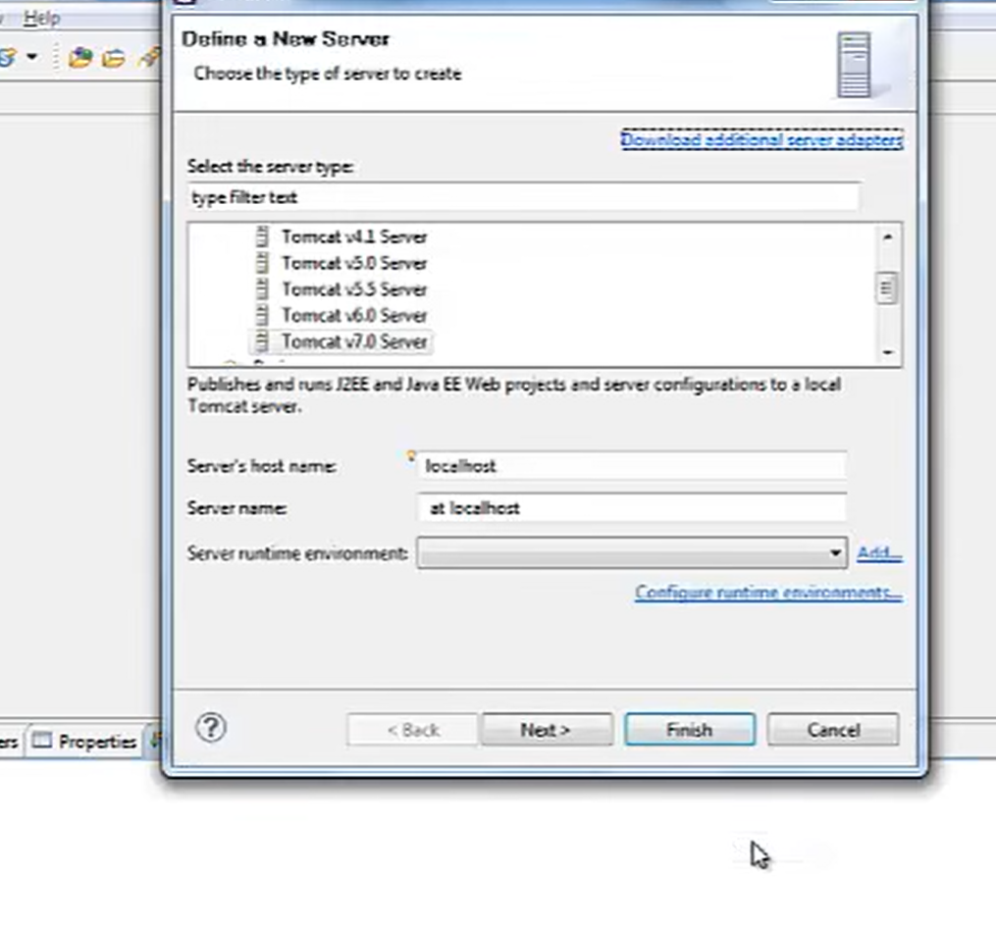
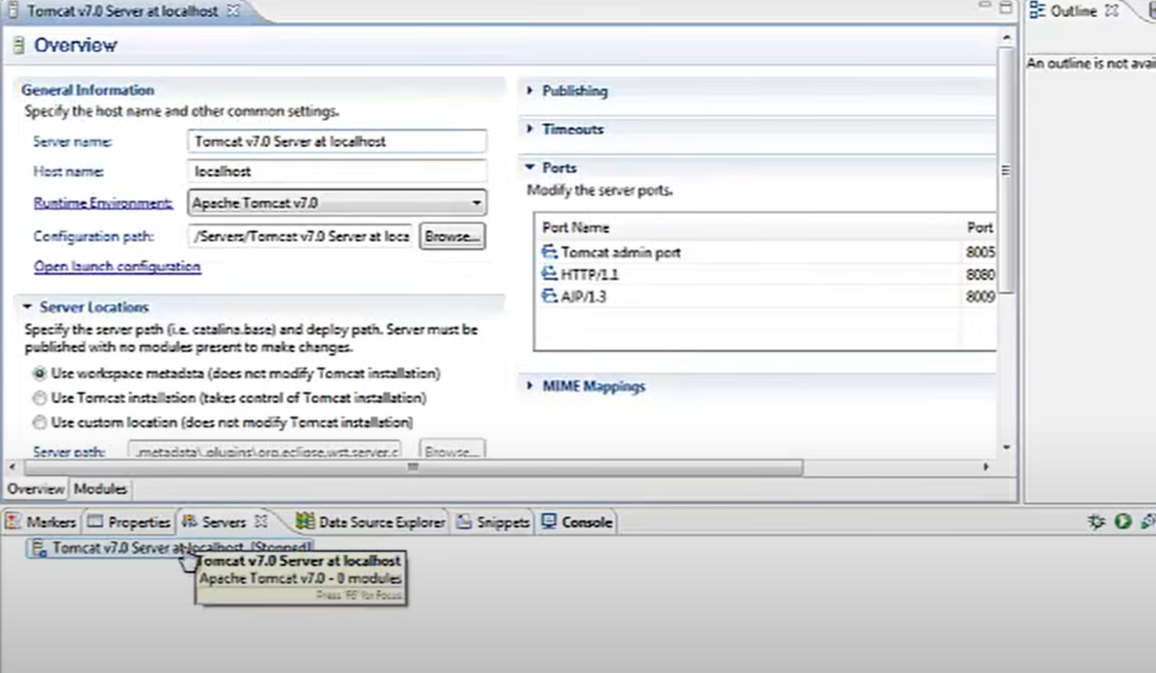
Plug tomcat into ellipse
Download apache tomcat.
Add it as a runtime environment then start your tomcat with http://localhost:8080/

Slide 18
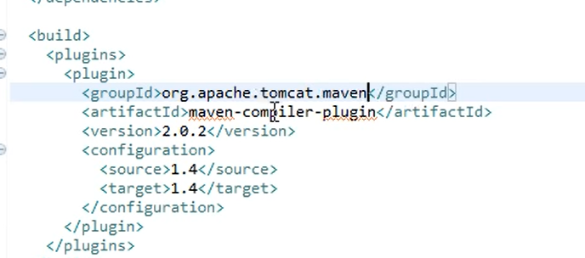
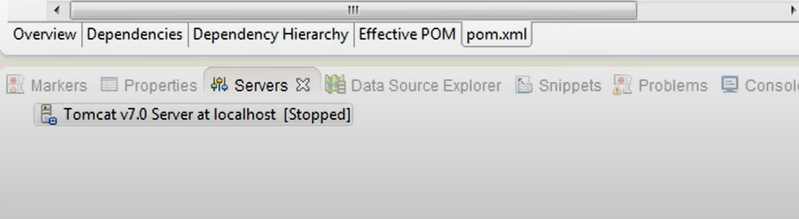
Maven compiler

Slide 19
Maven and tomcat One last look at ellipse
Our green button api uses
Tomcat jdbc - technology that allows Java technologies to connect to a wide variety of database types,
over a single protocol
<tomcat-jdbc.version>7.0.42</tomcat-jdbc.version>
<ehcache.version>2.6.6</ehcache.version>
<hsqldb.version>2.3.0</hsqldb.version>
<mysql.version>5.1.18</mysql.version>
Spring Web MVC
Spring Web MVC is the original web framework built on the Servlet API and has been included in the
Spring Framework from the very beginning. The formal name, “Spring Web MVC,”

Slide 20
citations
https://www.youtube.com/watch?v=CRvcm7GKrF0&t=84s
https://www.youtube.com/watch?v=FVyX8WA8Ng4
https://www.youtube.com/watch?v=R7DlcnrXfYE&t=244s
https://www.youtube.com/watch?v=iXGuV7PNrBw&t=207s
https://www.youtube.com/watch?v=YeC7XQho-O0
https://www.youtube.com/watch?v=bSaBmXFym30
https://www.youtube.com/watch?v=x8sMN4tossY

